Slide 1
A data-driven approach to predict the success of bank telemarketing
Applying the CRISP-DM Framework to Bank Marketing
Dataset: UCI DS Repository
Team Members:
Rohit Sinha
Nataliia Serhiichuk
Anoop Surendran

Slide 2
Business Problem, Literature & Hypothesis

Slide 3
Introduction
Business Problem:
  Outbound telemarketing for Term Direct Deposits (fixed-term accounts with locked funds until maturity) suffers from low conversion rates (~11.27%), wasting sales managers' time and creating customer call fatigue.
Literature Context:
  Direct bank marketing research demonstrates that data mining models can identify high-propensity clients prior to contact, drastically reducing call volume while maintaining campaign revenue.
  The dataset consists of the Portuguese retail bank data collected from 2008 to 2013, thus including the effects of the financial crisis.
  This research focus on targeting through telemarketing phone calls to sell long-term deposits.
  Within a campaign, the human agents execute phone calls to a list of clients to sell the deposit (outbound) or, if meanwhile the client calls the contact-center for any other reason, he is asked to subscribe the deposit (inbound). Thus, the result is a binary unsuccessful or successful contact.

Slide 4
Operational Framing
The Decision:
  Who acts: Bank sales managers and outbound call-center agents.
  Action taken: Instead of calling the entire client list indiscriminately, managers prioritize outbound calls to customers ranked above a specific predicted conversion probability threshold.
Unit of Analysis:
  One row equals: A single client contact record (one customer interaction outcome) within a specific direct marketing campaign.
  Dataset does not have a unique identifier column since the goal is not to identify the customer in real world, but to predict with the features provided during the campaign to predict if the customer would subscribe to the offer in future campaigns
Target Variable (y) & Timing:
  Definition: Binary outcome indicating whether the client subscribed to a term deposit (1 = Yes, 0 = No).
  Timing relative to prediction: The model generates a score before the phone call is placed; the true target y only becomes known after the phone call concludes. (Note: Call duration is excluded from features because it is unknown at prediction time).

Slide 5
Error Costs & Success Criterion
Cost of Classification Errors (Asymmetric Trade-off):
  False Positive (FP — Predicted "Yes", Actual "No"): Low Cost. Wasted agent call time (~5–10 minutes) and minor customer annoyance.
  False Negative (FN — Predicted "No", Actual "Yes"): High Cost. Lost term-deposit interest margin and missed long-term capital liquidity for the bank.
  Rough Cost Ratio: 1 : 10 (FP : FN) — Missing a genuine depositor is roughly 10 times more costly than making an unproductive phone call, justifying a lower probability threshold to boost Recall.
Success Criterion:
  Technical Benchmark: Achieve a ROC-AUC > 0.75 (using pre-call features only) and outperform a random baseline.
  Business Benchmark: Capture at least 70% of all actual subscribers while contacting only the top 30%–35% highest-scoring clients (a Lift > 2.0x in the top deciles).
Lecturer Grading Alignment Tip
Highlight the Ratio: Notice how the prompt mentions "rough ratios are enough; Section 5 uses them." Make sure your team keeps that 1:10 (FP:FN) ratio consistent when you build Section 5 (Evaluation / Cost-Benefit Matrix) later in the deck so the narrative ties together seamlessly.

Slide 6
Data Understanding (Exploratory Data Analysis)

Slide 7
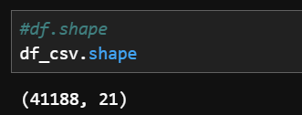
Dataset Information
The data is related with direct marketing campaigns of a Portuguese banking institution.
The data is related with direct marketing campaigns of a Portuguese banking institution.
More than one contact to the same client often required
The dataset used is bank-additional-full.csv with all examples (41188) and 20 inputs, ordered by date (from May 2008 to November 2010), very close to the data analyzed in [Moro et al., 2014] and our target variable y (‘yes’ or ‘no’)

Slide 8
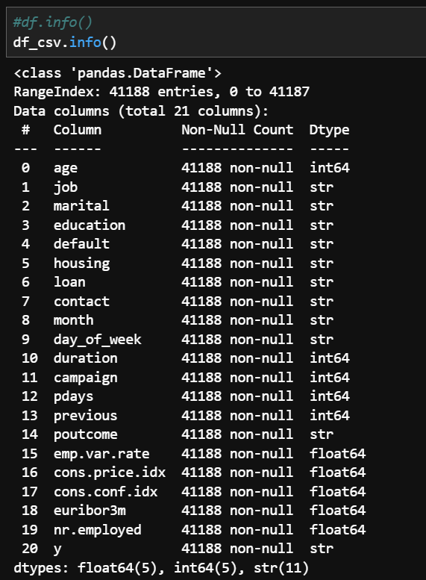

Slide 9
Keys and Duplicates
The UCI Bank Marketing dataset doe not have a unique identifier column since the goal is not to identify the customer in real world
For our dataset, a duplicated record does not necessarily mean the same customer appears twice
Two different customers can have identical values across all recorded features
We need to identify any exact row duplicates and remove them since to avoid any leakage in to test data
The data set has 12 exact row duplicates which needs treatment in the data preparation stage

Slide 10
Data Description Highlights
Age of the customers is 40 years old on average. Distribution skewed to the right with a maximum of 98.
More than 25.3% of the customers are admin.
Most of the customers are married, with university degree, and 52.4% have house loan.
Only ~0.01% had payment default. default is no for 79.1% of customers and unknown for about 21%, with almost no yes values
Conversion Rate ~ 11.27% (4,640 of 41,188), so the target is imbalanced at about 8 to 1.
poutcome = nonexistent for 35,563 rows (86.3%): most clients were never contacted before.
pdays = 999 is the placeholder for those clients, which is why the mean (962) and the quartiles (999) are meaningless.
duration and campaign have means well above their medians and extreme maxima (4918 and 56), so both are strongly right-skewed.
duration has a minimum of 0. Those calls have no talk time and are always no, which supports dropping it for a predictive model.
month = may accounts for 33.4% of contacts, so the campaign activity is concentrated in a few months.

Slide 11
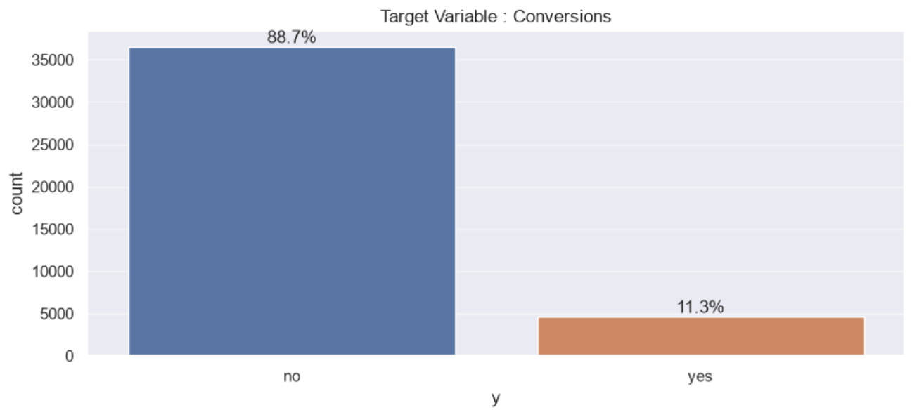
Target Distribution
The target variable shows very less conversion rate of 11.27% which is both a business reality, and a critical modelling challenge of class imbalance

Slide 12
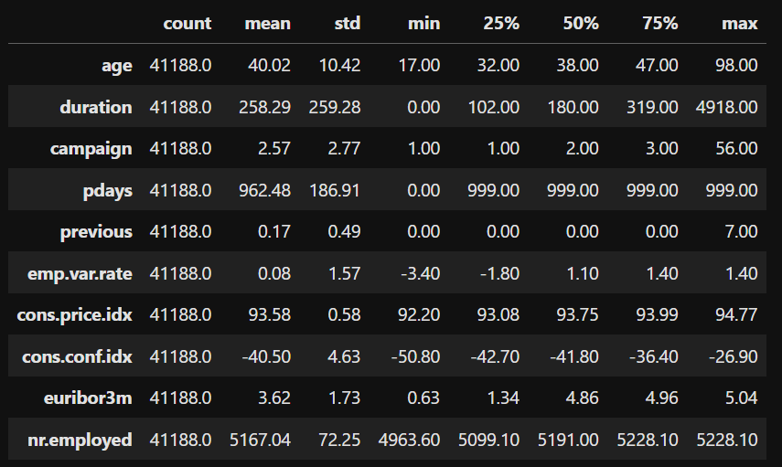
Univariate and Bivariate Analysis
Below is numeric variables description

Slide 13
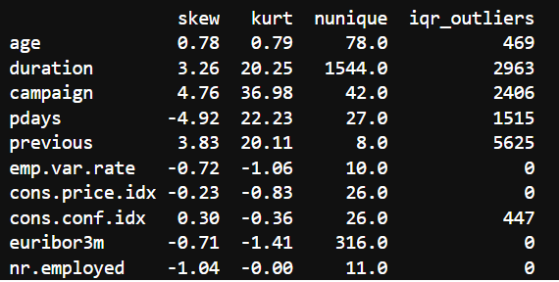
Skewness, unique, IQR range of the numerical columns
Numerical profiling reveals severe right-skewness in contact counts (campaign, previous)
Left-skew in pdays (-4.92) caused by the 999 'never contacted' sentinel code, we must recode pdays
We will drop ‘duration’ due to data leakage since the duration of the call is not known before the call
The macro-economic variables are fairly symmetric and will be checked for multicollinearity

Slide 14
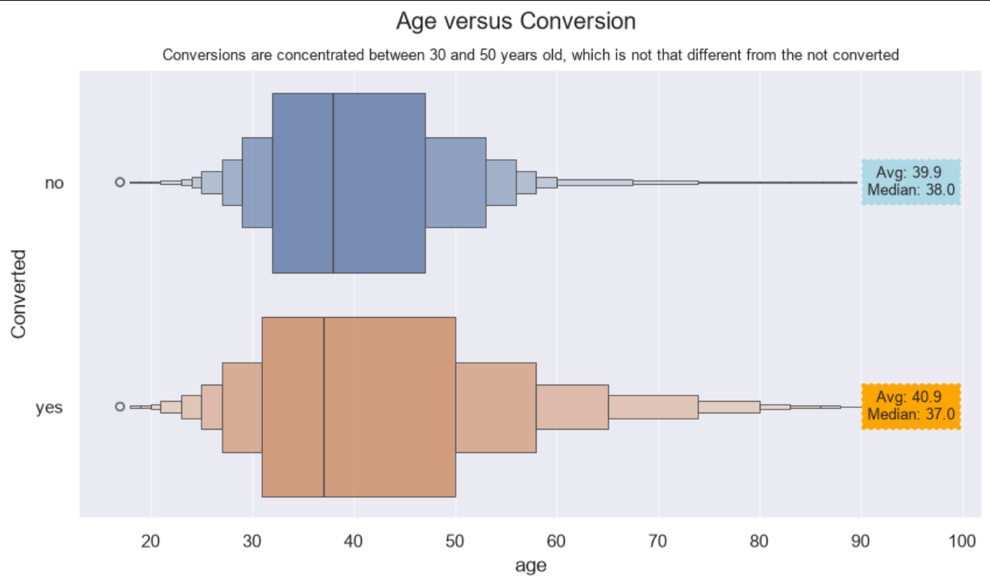
Bivariate Plots

Slide 15
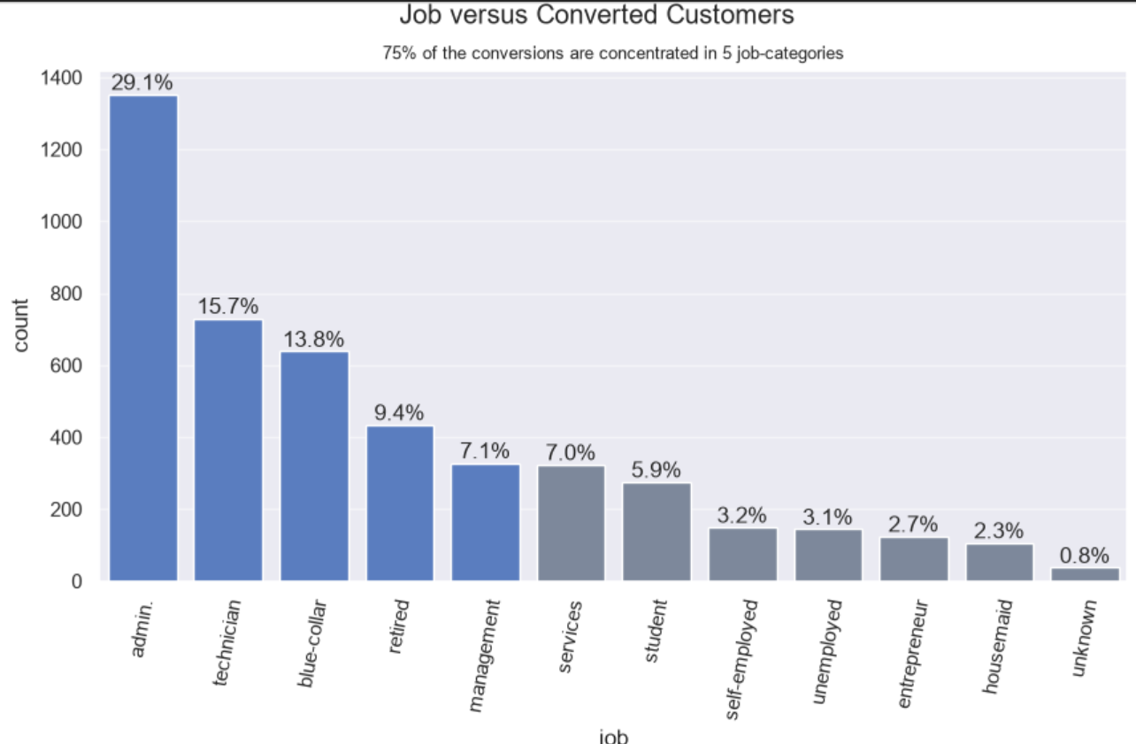

Slide 16
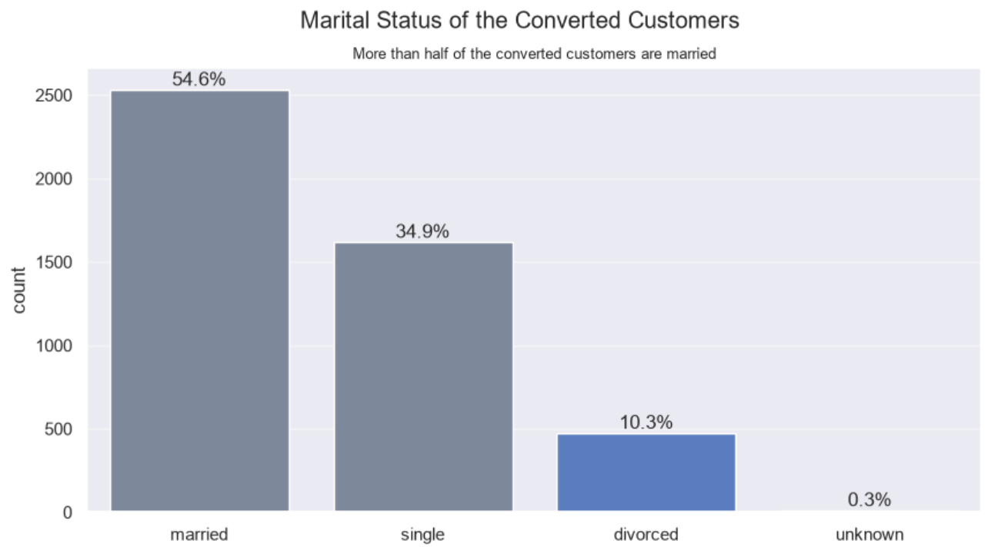
Married clients are the largest group of converters in absolute numbers, because they are about 60% of contacts. By rate, single clients convert best (about 14%), while married and divorced clients are both near 10%. The small “unknown” group (about 80 rows) converts at about 15%, but that is too few rows to read much int

Slide 17
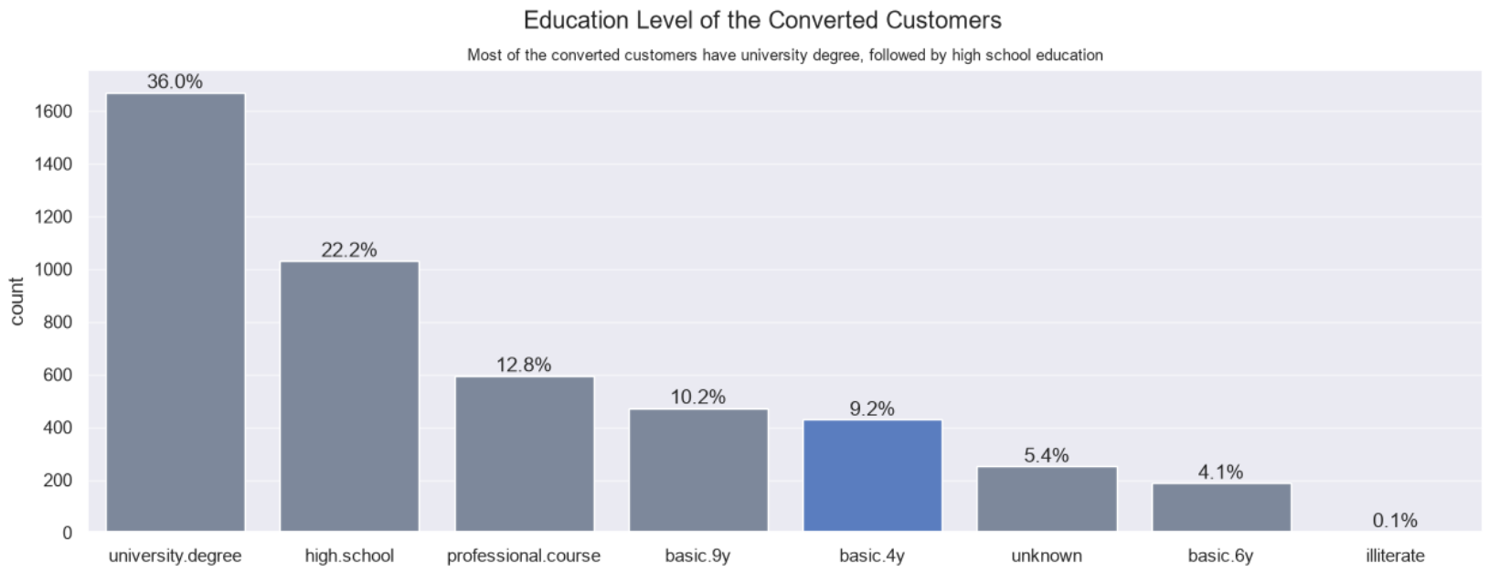
The conversion rate rises with education. University degree is about 13%, versus about 8% for basic.6y and basic.9y. University degree is also the largest converter group in absolute terms. “Illiterate” shows a high rate, but with only about 18 rows it is noise.

Slide 18
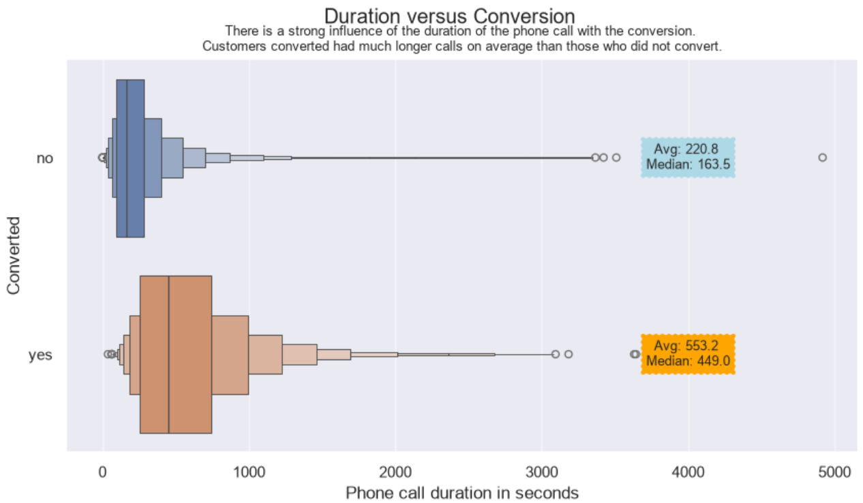
Duration is the strongest single signal. Converters talk for about 550 seconds on average, versus about 220 for non-converters. Duration and the number of contacts are only weakly related, so long calls don’t just mean more attempts. Duration is known only after the call ends, which makes it leakage for a predictive model. That is why it was dropped before the split

Slide 19
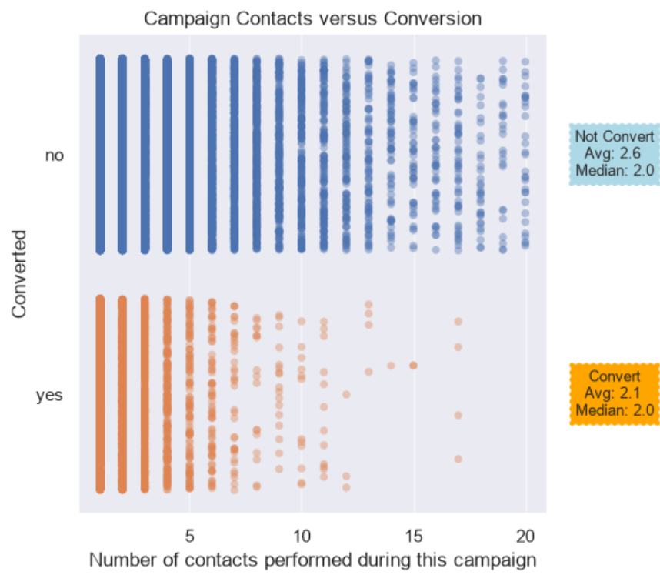
The variable is heavily right-skewed (most clients
get 1–3 contacts, with a maximum of 56).
Conversion falls as contacts increase, from about
13% at one contact to under 5% after about 10.
Repeated calling gives diminishing returns, so a
contact cap makes sense.

Slide 20
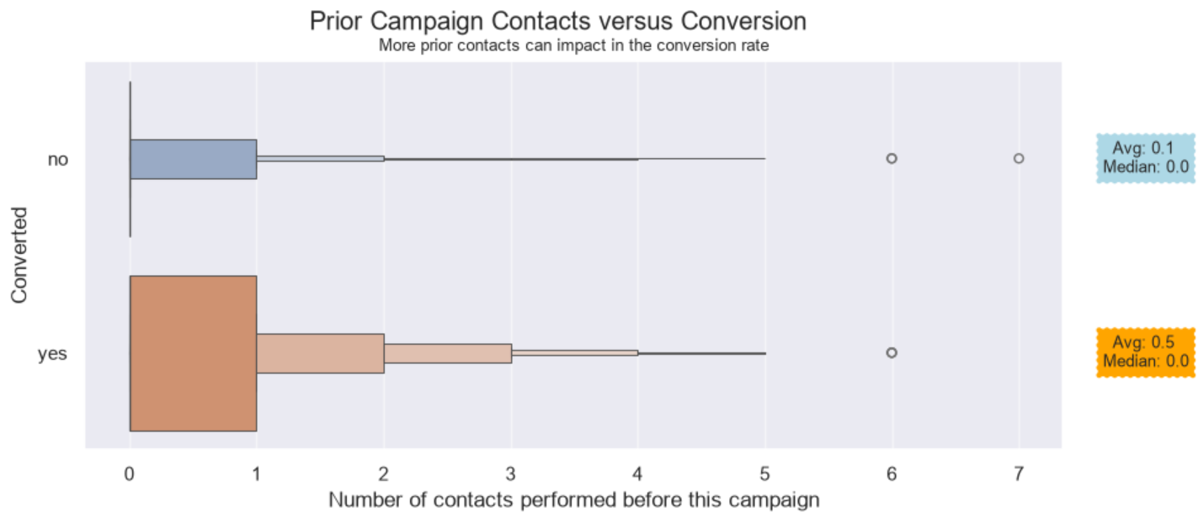
About 86% of clients have 0 previous contacts and convert at about 9%. Clients with 1 previous contact convert at about 21%, and 2 or more contacts convert even higher, though the counts are small

Slide 21
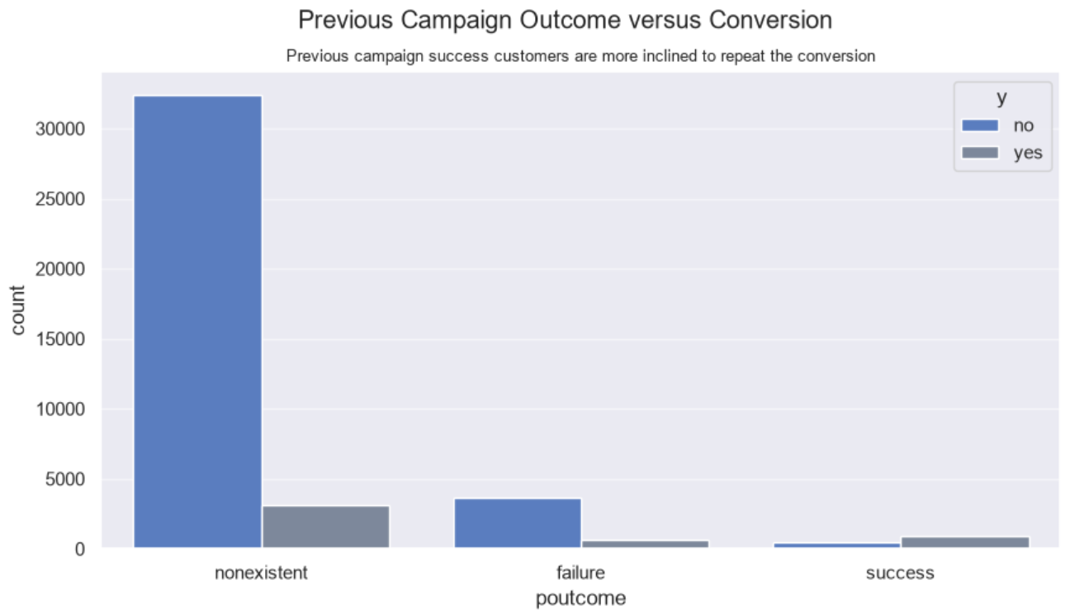
This is one of the strongest categorical predictors. Success converts at about 65%, failure at about 14%, and nonexistent (never contacted before) at about 9%. A previously successful client is a very warm lead, though only about 3% of the data falls in this group.

Slide 22
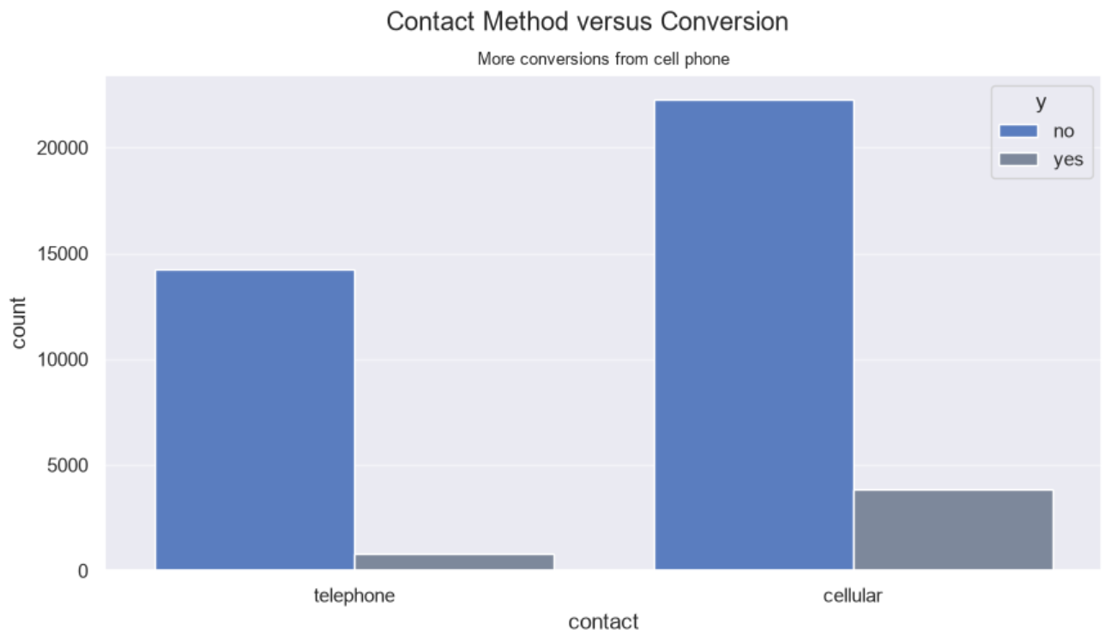
Cellular converts at about 15% versus about 5% for telephone, roughly three times higher. Cellular is also the majority channel (about 64%).

Slide 23
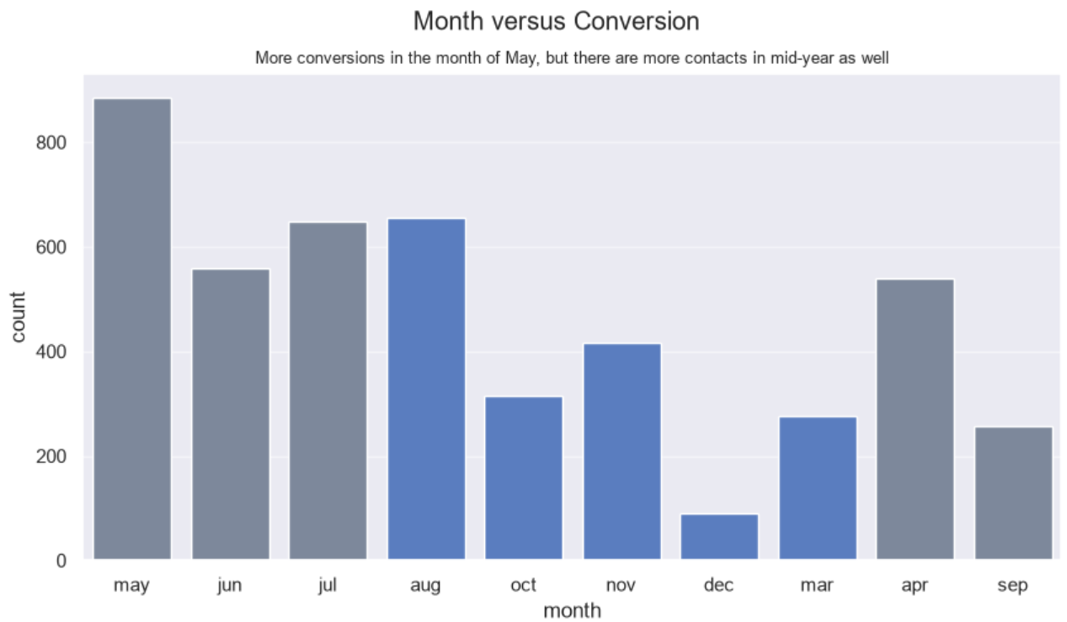
The picture is partly misleading. May has the most contacts (about a third of the data) but a low rate of about 6%. March, September, October and December convert at 40–50%, but on very small volumes. April is about 20%. January and February are absent. The data covers 2008–2010, so month is confounded with the economic cycle.

Slide 24
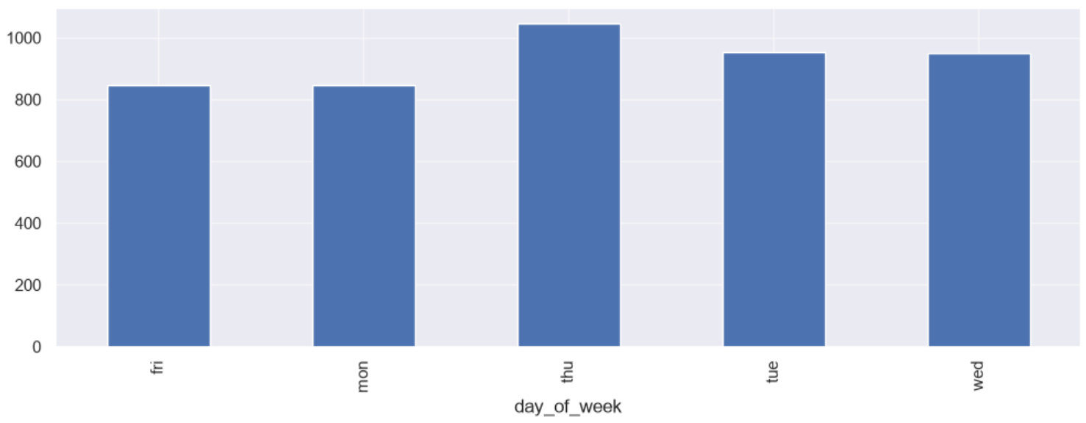
Volume is nearly even across weekdays. Rates differ only slightly: Thursday about 12%, Monday about 10%. This is a weak effect, which supports our decision to drop it.

Slide 25
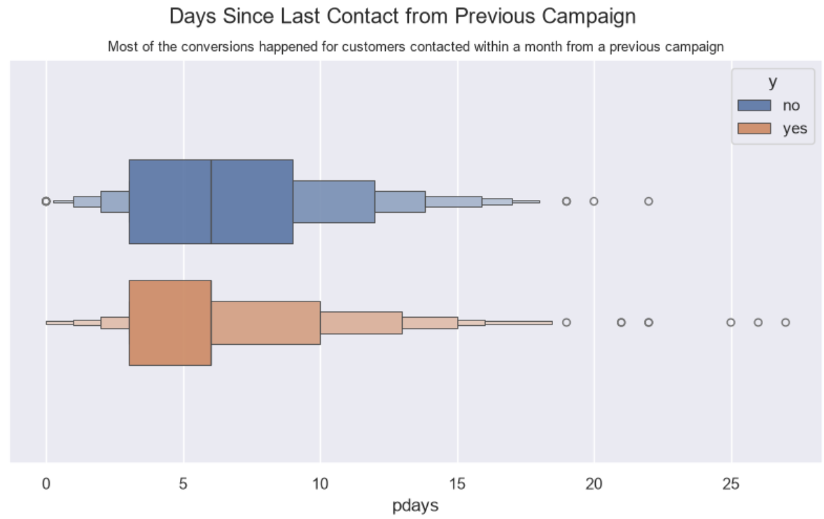
999 is a placeholder for “never contacted”, and it covers about 96% of rows. Those rows convert at about 9%, versus about 60% for clients actually contacted before. Among those, the more recently they were contacted, the higher the conversion. We have handled it with a flag-plus-fill treatment.

Slide 26
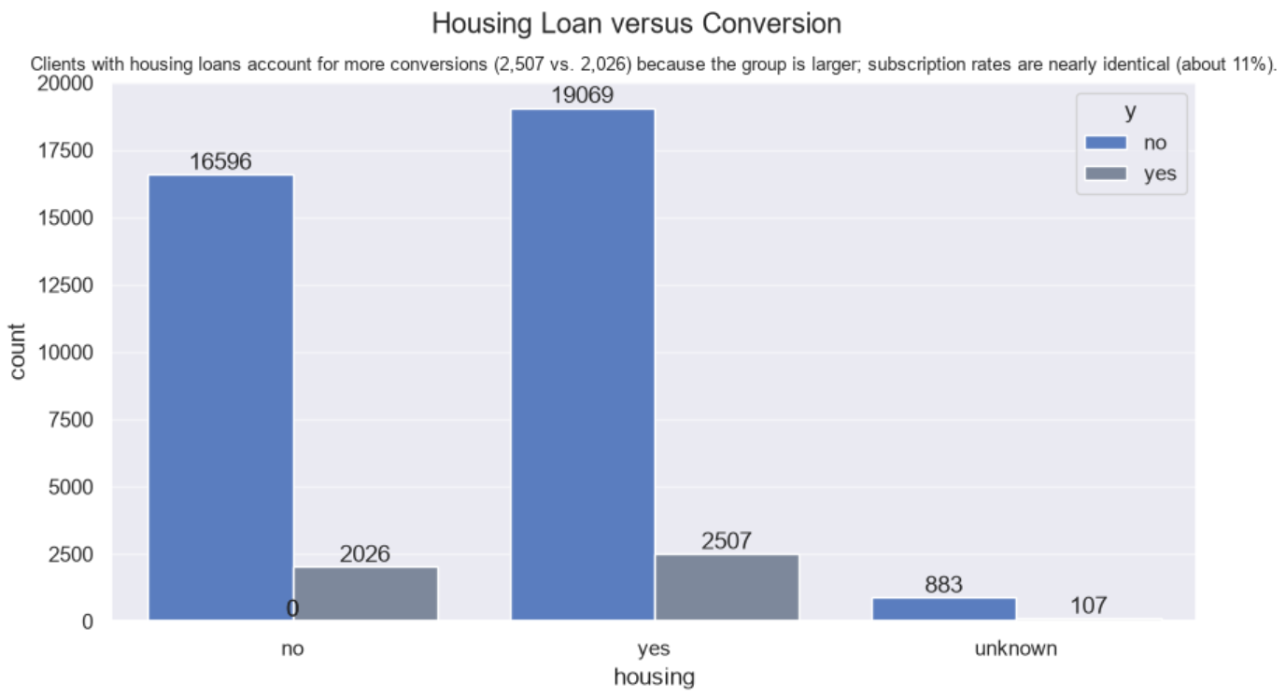
The rates are nearly identical (about 11.6% for yes, 10.9% for no). This is weak or no signal.

Slide 27
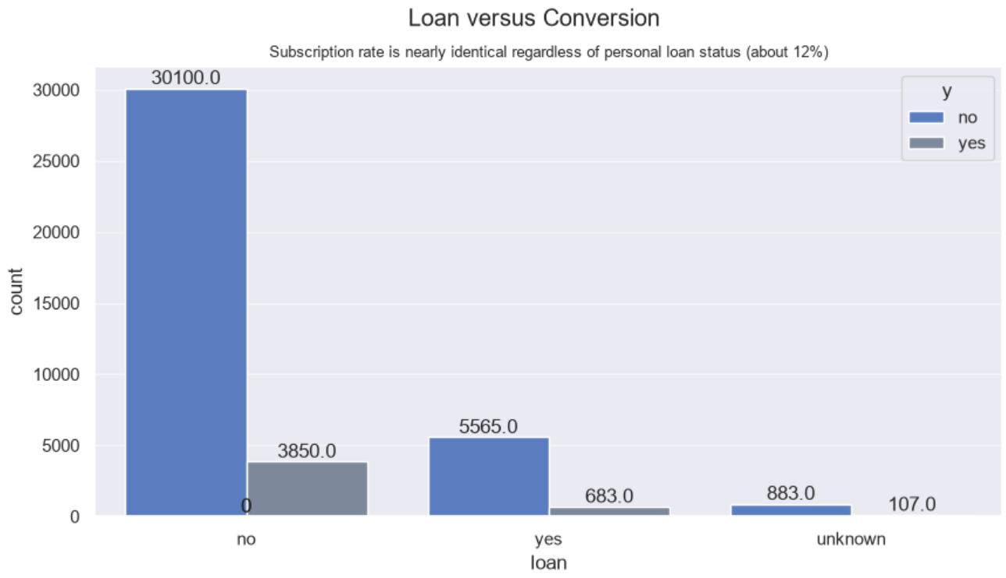
The rates are also nearly identical (about 11% for yes and no). There is no meaningful effect.

Slide 28
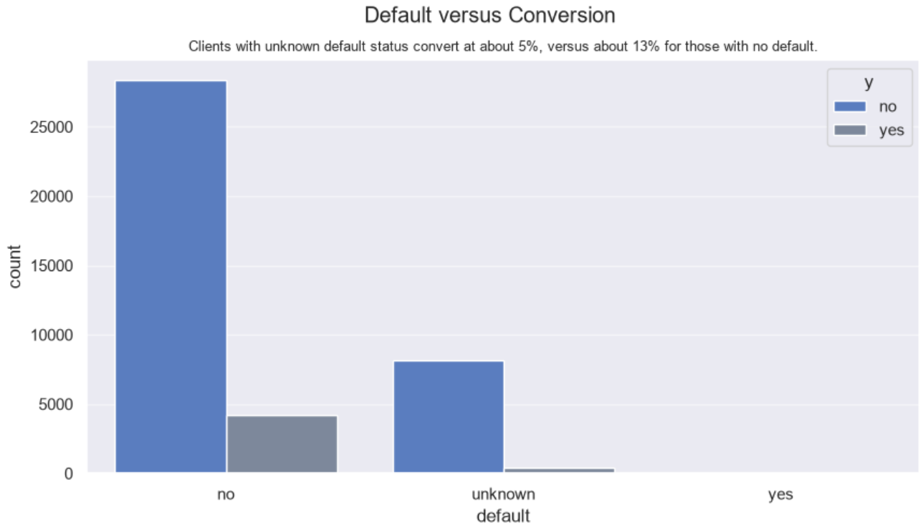
“No” converts at about 13%, while “unknown” converts at about 5%, so unknown behaves like a distinct low-conversion segment. This supports keeping “unknown” as its own category. Only 3 clients have “yes” and none converted, so we can’t draw conclusions from that group. Overall 11% subscription for the group

Slide 29
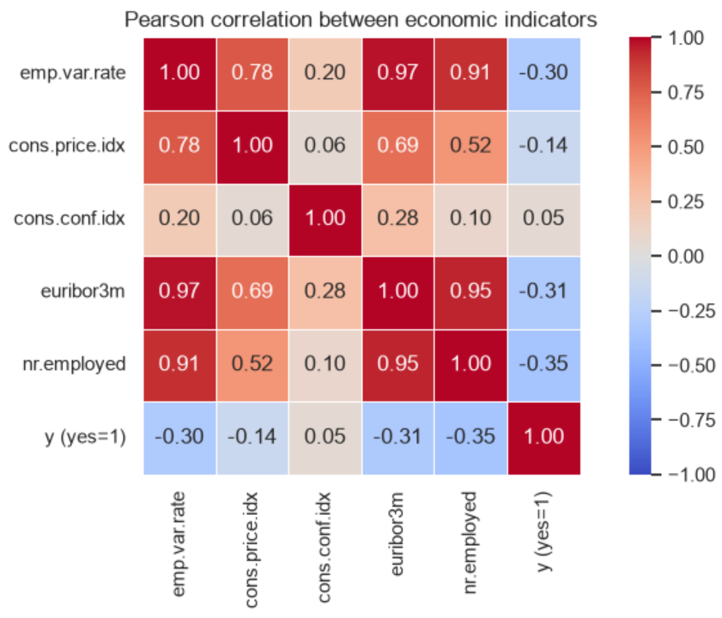
The heatmap shows a strong multicollinearity
problem among the macro-variables
very correlation is modest, and none exceeds
0.35 in absolute value
The three strongest variables have almost the
same correlation with y, which already hints
that they carry the same information
emp.var.rate, euribor3m and nr.employed.
Their pairwise correlations are
euribor3m–emp.var.rate 0.97,
euribor3m–nr.employed 0.95, and emp.var.rate–nr.employed 0.91. All three track the same business-cycle and interest-rate regime
cons.price.idx is moderately linked and cons.conf.idx is almost independent of the rest

Slide 30
Exploration Summary
The converter profile is a 37 to 40 year old person, working on an admin role, married, with a refined education of at least secondary level, most of them with housing loan than personal loan, thus showing some debt.
Most conversions happened on the first contact.
Customers not converted on the first contact received something between 2 to 4 contacts before conversion. Refer "campaign" variable
The more contacts from this campaign, the lower the probability of a customer have converted.
Customers never contacted before need more contacts on average than existing customers. This is show by the "previous" variable
Contacts from previous campaigns can impact on the conversion of the current campaign, possibly indicating that relationship over time matters.
Customers that converted in previous campaigns are more likely to repeat conversion, while failure to convert also show a tendency to not convert again.
The longer the contacts, the higher the chance of converting. People who converted stayed connected to the call up to 4 times more seconds. However, we can't use the duration of the call as a predictor.
Looking at the graphics after exploration, the variables duration, job, marital, previous, campaign, default, housing, loan are interesting for modeling, as they impact more directly on the target variable. However, duration cannot be used, as it is not possible to know the duration of a phone call until it ends. The variable poutcome can also be included, but it has too many nonexistent values, so it needs further treatment to be considered. We have include only nr.employed and excluded emp.var.rate and euribor3m from three macro-economic variables based on the vif. Only one macro-economic indicator was retained. emp.var.rate and euribor3m were removed because they were almost collinear with nr.employed (variance inflation factors above 30), and cons.price.idx and cons.conf.idx were removed to keep a single macro-economic variable. nr.employed was chosen because it had the strongest correlation with the target (-0.35) and the lowest redundancy among the correlated group.

Slide 31
Data Preparation

